Slide 1
Christ’s Appearance To John
Revelation 1:9-20

Slide 2
Verse 9
“I, John, both your brother and companion in the tribulation and kingdom and patience of Jesus Christ, was on the island that is called Patmos for the word of God and for the testimony of Jesus Christ.”
Could have appealed to them as an “apostle” but chose “brother” and “companion”
  suggests his personal relationship

Slide 3
Verse 9
“I, John, both your brother and companion in the tribulation and kingdom and patience of Jesus Christ, was on the island that is called Patmos for the word of God and for the testimony of Jesus Christ.”
“He was their companion: the children of God should choose communion and society with each other. He was their companion in tribulation: the persecuted servants of God did not suffer alone, the same trials are accomplished in others. He was their companion in patience, not only a sharer with them in suffering circumstances, but in suffering graces. . .”
(Matthew Henry’s Commentary Acts to Revelation, Mclean Virginia: Mac Donald Publishing Co., p. 1121.)

Slide 4
Verse 9
“I, John, both your brother and companion in the tribulation and kingdom and patience of Jesus Christ, was on the island that is called Patmos for the word of God and for the testimony of Jesus Christ.”
Dispels the false idea that the “kingdom” was not established in the first century
  John was in the “kingdom” as much as he was in “tribulation”
  “He has delivered us from the power of darkness and conveyed us into the kingdom of the Son of His love” (Col. 1:13)

Slide 5
Verse 9
“I, John, both your brother and companion in the tribulation and kingdom and patience of Jesus Christ, was on the island that is called Patmos for the word of God and for the testimony of Jesus Christ.”
A small rocky island in the Aegean Sea
About 10 miles in length and five to six miles in width
Closest to the church at Ephesus

Slide 6
Verse 9
“I, John, both your brother and companion in the tribulation and kingdom and patience of Jesus Christ, was on the island that is called Patmos for the word of God and for the testimony of Jesus Christ.”
“On account of its rocky, barren, and desolate nature the Roman government used the island as a place of banishment for criminals. The prisoners were compelled to work the mines of the island”
Unger, Merrill F., The New Unger’s Bible Dictionary, Chicago: Moody Press, p. 967. 1988.

Slide 7
Verse 9
“I, John, both your brother and companion in the tribulation and kingdom and patience of Jesus Christ, was on the island that is called Patmos for the word of God and for the testimony of Jesus Christ.”
Banished not because he was a criminal, but because he was a Christian
“But let none of you suffer as a murderer, a thief, an evildoer, or as a busybody in other people’s matters. Yet if anyone suffers as a Christian, let him not be ashamed, but let him glorify God in this matter”
(1 Pet. 4:15, 16).
Was persecuted the same reason others were beheaded (Rev. 6:9)

Slide 8
Verse 10
“I was in the Spirit on the Lord’s Day, and I heard behind me a loud voice, as of a trumpet”
“In the Spirit”
  Likely some kind of “trance”
  (cf. 4:2; Acts 10:10ff)
  Ezekiel 3:12, “Then the Spirit lifted me up, and I heard behind me a great thunderous voice: Blessed is the glory of the LORD from His place!”

Slide 9
Verse 10
“I was in the Spirit on the Lord’s Day, and I heard behind me a loud voice, as of a trumpet”
Not “the Day of the Lord”
Not “the Sabbath day”
But, the first day of the week!
  whenever John spoke of the seventh day he referred to it as the “Sabbath” (Jn. 5:9, 10, 16, 18; 7:22, 23; 9:14, 16; 19:31)
  “Lord’s Day” is a new phrase in the Bible
    O.T had “Sabbath”
    N.T has “Lord’s Day”
    Why should the New Covenant have an Old Covenant day?

Slide 10
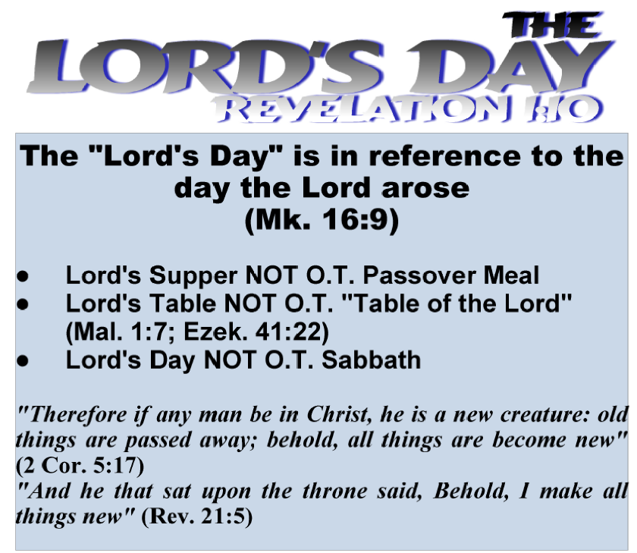

Slide 11
“Lord’s Day,” “Ark of the Covenant,” & “The Sabbath”
14 "Return, O backsliding children," says the LORD; "for I am married to you. I will take you, one from a city and two from a family, and I will bring you to Zion.
15 "And I will give you shepherds according to My heart, who will feed you with knowledge and understanding.
16 "Then it shall come to pass, when you are multiplied and increased in the land in those days," says the LORD, "that they will say no more, ‘The ark of the covenant of the LORD.’ It shall not come to mind, nor shall they remember it, nor shall they visit it, nor shall it be made anymore.
17 "At that time Jerusalem shall be called The Throne of the LORD, and all the nations shall be gathered to it, to the name of the LORD, to Jerusalem. No more shall they follow the dictates of their evil hearts. --Jeremiah 3:14-17

Slide 12
Jeremiah 3:14-17
This passage speaks of a good time
The shepherds are good
The growth was good
The ark not coming into “mind” or being “made” is likewise a good thing
The reason: the New Covenant will have come into “mind” and “made”

Slide 13
Jeremiah 31:31-34
31 "Behold, the days are coming, says the LORD, when I will make a new covenant with the house of Israel and with the house of Judah—
32 "not according to the covenant that I made with their fathers in the day that I took them by the hand to lead them out of the land of Egypt, My covenant which they broke, though I was a husband to them, says the LORD.
33 "But this is the covenant that I will make with the house of Israel after those days, says the LORD: I will put My law in their minds, and write it on their hearts; and I will be their God, and they shall be My people.
34 "No more shall every man teach his neighbor, and every man his brother, saying, ‘Know the LORD,’ for they all shall know Me, from the least of them to the greatest of them, says the LORD. For I will forgive their iniquity, and their sin I will remember no more."

Slide 14
- sabbath command was in the ark of the covenant (Deut. 4:13; 1 Kin. 8:9)
- if ark doesn’t come to mind, then sabbath doesn’t come to mind
- if ark is not “made” then sabbath is not “made”
- Sabbatarians must prove that the sabbath command is of the “New Covenant”
Jeremiah 3:14-17
(Ark of covenant will no longer come to mind nor be made)
Jeremiah 31:31-34
(New Covenant will not be according to the Old Covenant)

Slide 15
“Lord’s Day” Prophesied
"The stone which the builders rejected has become the chief cornerstone. This was the Lord's doing; it is marvelous in our eyes. This is the day the Lord has made; we will rejoice and be glad in it"
(Ps. 118:22-24)
  who is the stone (Acts 4:10-12)?
  what was the Lord’s doing?
    Making the rejected stone the chief cornerstone
  what was the day that God did such?
    when the disciples rejoiced and were glad in it!

Slide 16
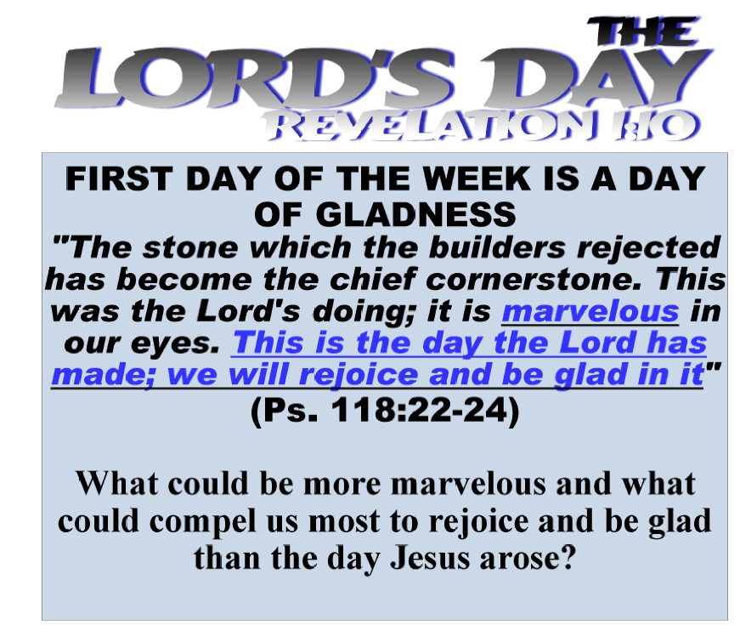

Slide 17
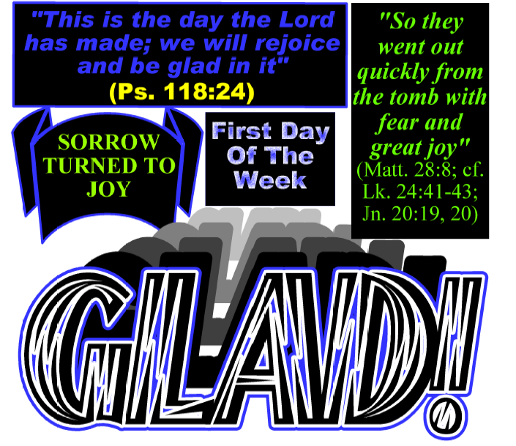

Slide 18
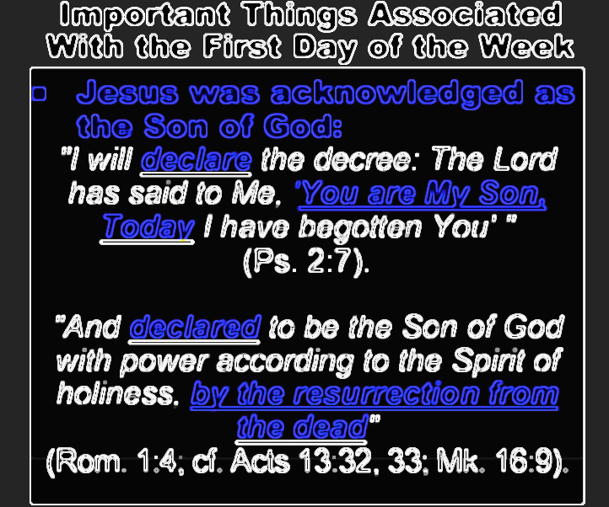

Slide 19
Verse 10
“I was in the Spirit on the Lord’s Day, and I heard behind me a loud voice, as of a trumpet”
“Lord’s” (Gk. kuriakos) is found only twice in the New Testament
  Revelation 1:10
  1 Corinthians 11:20, “Therefore when you come together in one place, it is not to eat the Lord’s Supper”
The “Lord’s Day” and the “Lord’s Supper” are connected. . .

Slide 20
Acts 20:7
Lord’s Day
Mark 16:9
“Now on the first day of the week, when the disciples came together to break bread, Paul, ready to depart the next day, spoke to them and continued his message until midnight.”
Lord’s Supper (cf. Acts 2:42; 1 Cor. 11:23, 24)

Slide 21
Verse 11
“saying, "I am the Alpha and the Omega, the First and the Last," and, "What you see, write in a book and send it to the seven churches which are in Asia: to Ephesus, to Smyrna, to Pergamos, to Thyatira, to Sardis, to Philadelphia, and to Laodicea."
commanded to write the book of Revelation
writing was one of the chief ways to communicate God’s word to others

Slide 22
Christ Among the Seven Churches (1:12-16)
saw seven golden lampstands
  represent churches (1:20)
  lampstand gives light
  shine forth the light (Matt. 5:16; Eph. 5:8)
  “golden” is costly material

Slide 23
Christ Among the Seven Churches (1:12-16)
Christ is in the midst of the churches (v. 13)
  What thoughts should surface from this fact (cf. Matt. 28:20)?

Slide 24
The GOD-MAN
“Son of Man” (v. 13)
“Son of God” (2:18)
speaks of his humanity and deity
  Romans 9:5 “Of whom are the fathers and from whom, according to the flesh, Christ came, who is over all, the eternally blessed God. Amen” (NKJV)

Slide 25
Symbols of the GOD-MAN
garment
  kingly nature
gold band around chest
  possibly priestly duty (cf. Ex. 28:5-14)
  compliments high rank/authority
head and hair white
  radiance, dignity, and sinless
  resplendent (Matt. 17:2)

Slide 26
Symbols of the GOD-MAN
eyes of fire
  piercing and penetrating, all things are naked before him (Heb. 4:13)
  Daniel 10:6
feet as brass
  authority to tread over his enemies
voice
  visualize the crashing of a waterfall, thundering voice

Slide 27
Holding Seven Stars (1:16)
in right hand
stars identified as angels (viz. messengers, e.g., preacher, teacher, elders, etc.)
  in Christ’s hand—these messengers worked within Christ’s authority; they existed by his power
  “. . . For if I still please men, I would not be a bondservant of Christ” (Gal. 1:10; cf. 1 Cor. 9:16)

Slide 28
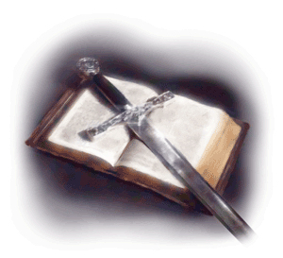
Two-Edged Sword (1:16)
proceeds out of mouth
  “But with righteousness He shall judge the poor, And decide with equity for the meek of the earth; He shall strike the earth with the rod of His mouth, And with the breath of His lips He shall slay the wicked” (Is. 11:4)
  “. . . and the sword of the Spirit, which is the word of God” (Eph. 6:17; cf. Heb. 4:12)

Slide 29
Countenance (1:16)
like the sun shining in its strength
  Acts 26:13
  A previous display to John
  (Matt. 17:1-3)

Slide 30
Verse 17
And when I saw Him, I fell at His feet as dead. But He laid His right hand on me, saying to me, "Do not be afraid; I am the First and the Last.
overwhelmed at the sight of him
  even though of all men, Peter, James and John were the most familiar with Him
Christ comforts with compassion
  like the righteous who meet the Lord on Judgment day (2 Thess. 1:5-7; Rev. 21:4)
  cf. Daniel 10:5-12
“First and the Last” mentioned three times in this chapter (vv. 8, 11)
  he is the origin of all and the last judge of all

Slide 31
Verse 17-20 (Thoughts of Comfort)
Jesus alleviates John’s fears by reminding him that “I am He who was dead”
  This was the same One John saw hanging on the cross and in that pain
  The same One who was concerned about his condition (Jn. 19:25-27)

Slide 32
Verse 17-20 (Thoughts of Comfort)
Comfort from His resurrection saying, “I am alive forevermore”
  It was this event that turned their sorrows to joy and emboldened all the disciples to take the gospel out to the world. He conquered death in His death to always live
Comfort from His position of dominion over the invisible worlds of Death and Hades.
  Death claims the body, Hades claims the soul. But Jesus has power over both!

Slide 33
Verse 17-20 (Thoughts of Comfort)
Comfort with a work to do
  He wants him to write things down.
  The things that he saw, the things which are (presently), and the things which will take place (future).
Comfort with the understanding, the “meaning” of the symbols
(v. 20)

Slide 34
Answers from what John saw:
Revelation answers the question as to whether being a Christian is worth it when the wicked can prosper and grow in power
Revelation answers that even in though the world is in turmoil, Jesus has not lost control
Revelation answers that life is more than what you see and hold
  real life comes after this short one is over.

